Slide 1
THEORY OF COMPUTATION
-TOPIC-
MINIMIZATION OF FINITE AUTOMATA

Slide 2
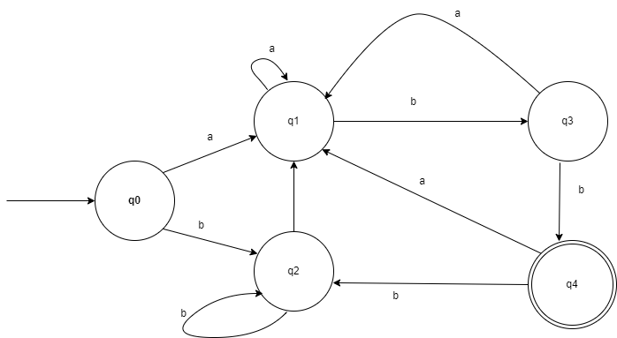
Problem 4:
Initial/Start state
Final state

Slide 3

Step2: Draw the upper triangular matrix for the given problem.
(q₀,q₁) (q₀,q₂)(q₀,q₃)(q₀,q₄)
(q₁,q₂)(q₁,q₃)(q₁,q₄)
(q₂,q₃)(q₂,q₄)
(q₃,q₄)

Slide 4
Step3:Draw the table filling format to mark the state reachable to final state.
q₁ | ?
q₂ | ? | ?
q₃ | ? | ? | ?
q₄ | X | X | X | X
 | q₀ | q₁ | q₂ | q₃

Slide 5
Step4: Draw the transition table for unmarked states.
δ | Input- a | Input-b
(q₀,q₁) | (q₁,q₁) | (q₂,q₃)
(q₀,q₂) | (q₁,q₁) | (q₂,q₂)
(q₀,q₃) | (q₁,q₁) | (q₂,q₄) (✔)
(q₁,q₂) | (q₁,q₁) | (q₃,q₂)
(q₁,q₃) | (q₁,q₁) | (q₃,q₄) (✔)
(q₂,q₃) | (q₁,q₁) | (q₂,q₄) (✔)

Slide 6
Note:
Below the transition table the state which are reachable final state can be marked,if it is already marked considered respectively dell value for marking .
If the both value reachable values final state such as F cannot be considered for marking.

Slide 7
Step5:Draw the table filling format to mark the respective cells from the above transition table.
q₁ | ?
q₂ | ? | ?
q₃ | X | X | X
q₄ | X | X | X | X
 | q₀ | q₁ | q₂ | q₃

Slide 8
Step6:The final unmarked states.
The unmarked states are,
Therefore, total number of states are reduced from 5 to 3.
(q₀,q₁) | (q₀,q₂) | (q₁,q₂)

